Slide 1
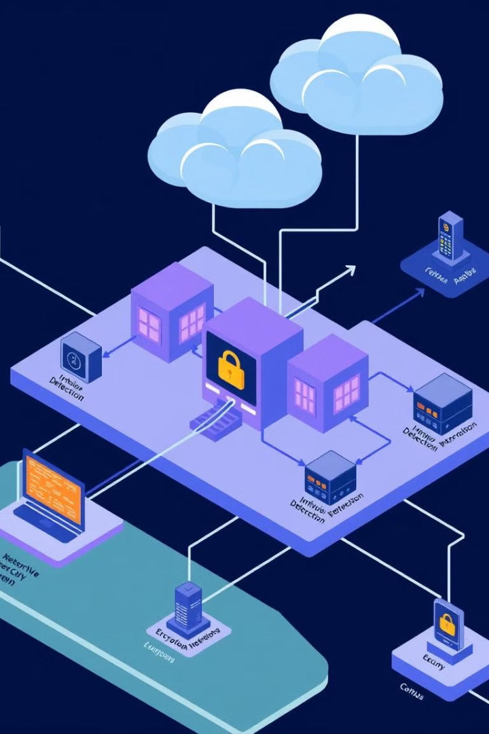
Building & Securing a Campus Network
Establishing a reliable and secure campus network is crucial for fostering academic excellence and connectivity. This presentation will explore the key considerations, infrastructure components, and best practices for building and maintaining a robust campus network.
By:Zeyad Ebrahim/ Khaled Ghanem /Sohail Abdullah Mohamed Elhadad /Abdelrahman Mohamed /Kamal Mohamed

Slide 2
Key Considerations for Campus Network Design
Scalability
Reliability
Flexibility
The network must be able to handle growing user demands and future expansion without compromising performance.
Ensuring consistent uptime and minimal disruptions is essential for uninterrupted access to critical resources.
The network should be adaptable to accommodate evolving technologies, changing user needs, and emerging use cases.

Slide 3

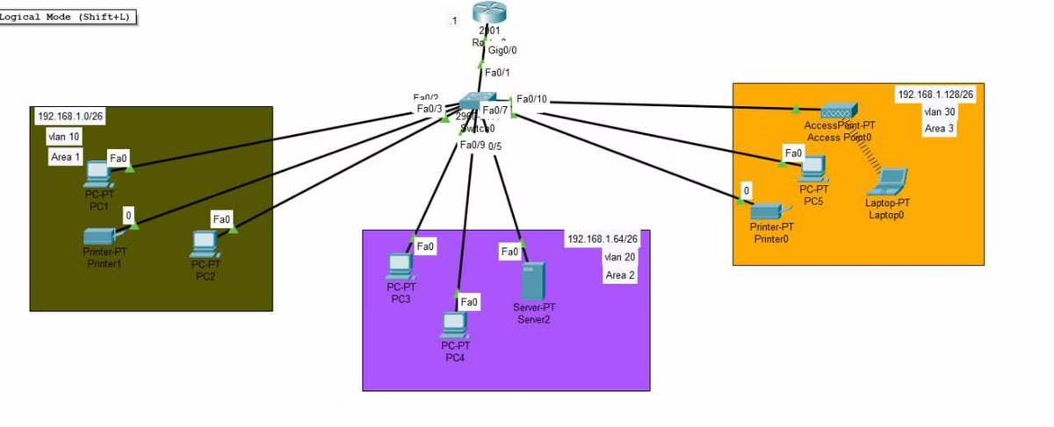
NETWORK TOPOLOGY

Slide 4
Ip addressing schema
26/192.168.1.0 Network (vlan 10):
• PC1: 192.168.1.3 • PC2: 192.168.1.2 • Printer1: 192.168.1.4 • Default Gateway (Router): 192.168.1.1
26/192.168.1.64 Network (vlan 20):
• РСЗ : 192.168.1.67 • РС 4: 192.168.1.66 • Server2: 192.168.1.68 • Default Gateway (Router): 192.168.1.65
26/192.168.1.128 Network (vlan 30):
• PC5: 192.168.1.131 • PrinterO: 192.168.1.130 • Laptop0: 192.168.1.132 • Default Gateway (Router): 192.168.1.129

Slide 5

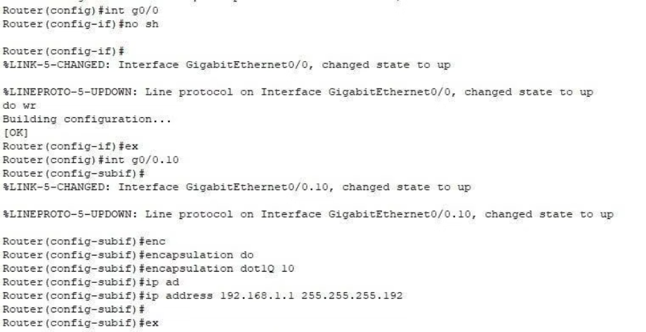
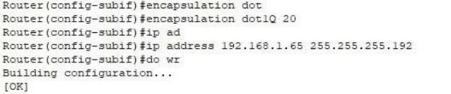
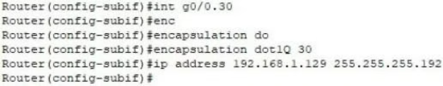
Router configuration
Router config 1:
Router config 2:
Router config 3:

Slide 6
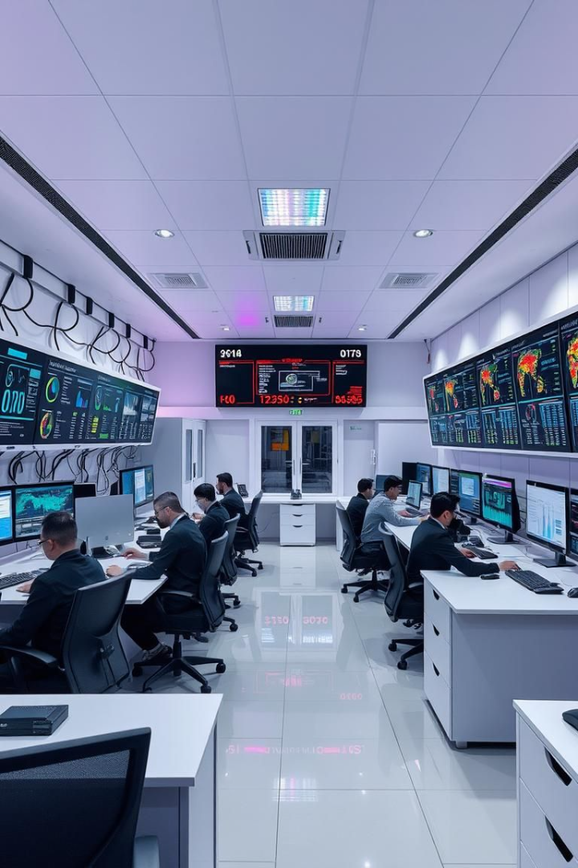
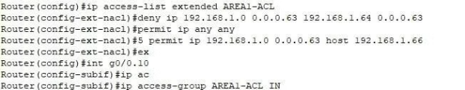
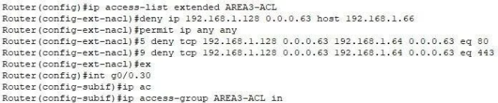
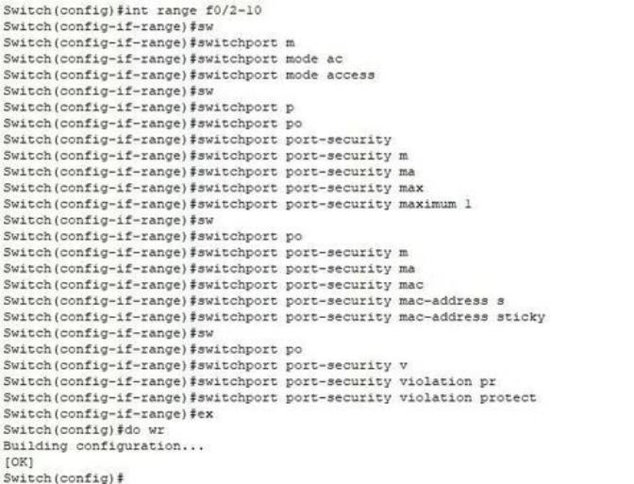
Accesslist 1:
ACL area 3:
Port secuirty:

Slide 7

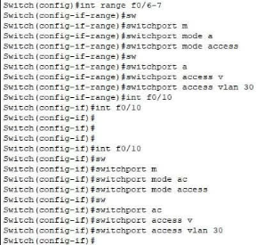
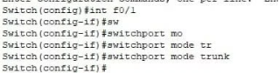
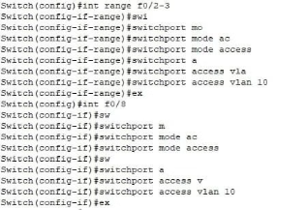
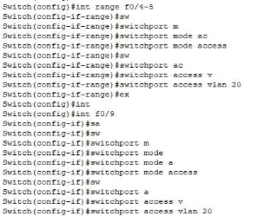
Switch port access:

Slide 8
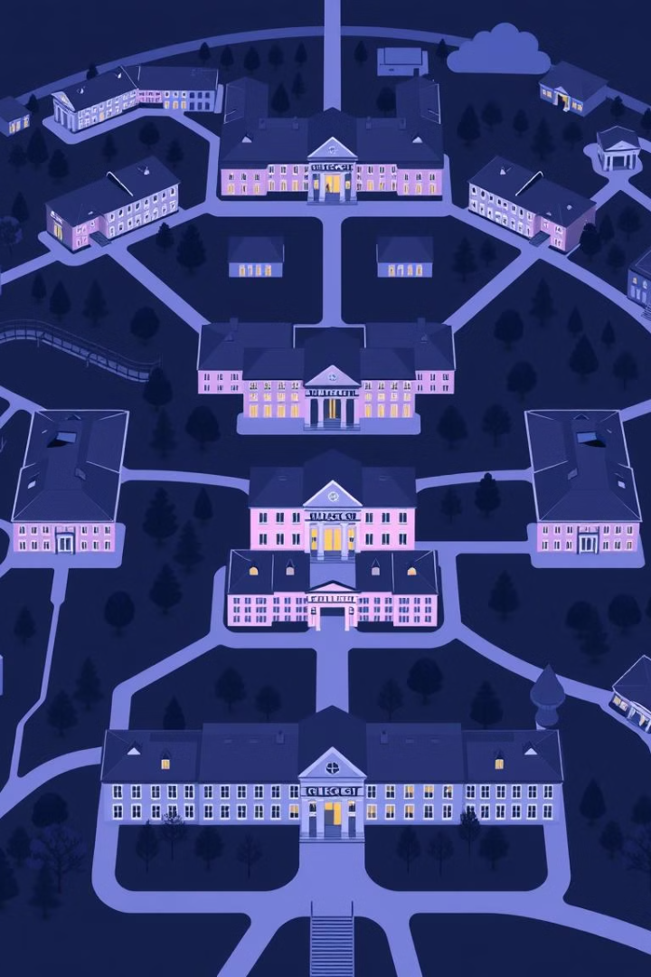
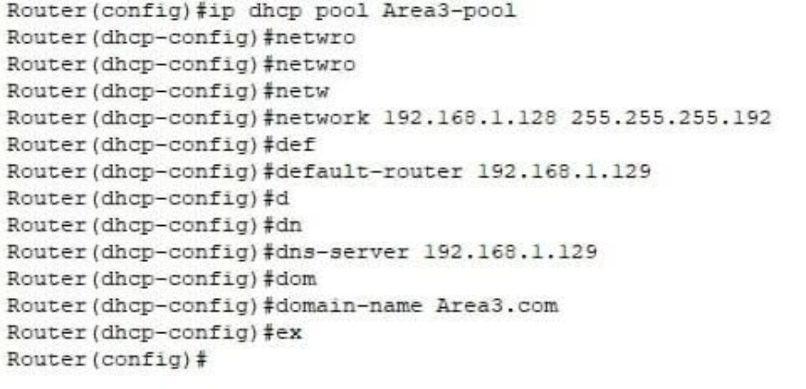
Area 3 DHCP:

Slide 9
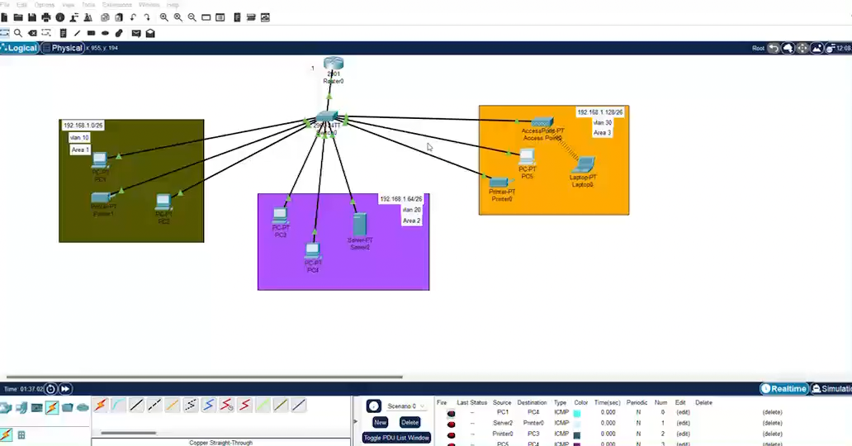
Final Testing:

Slide 10
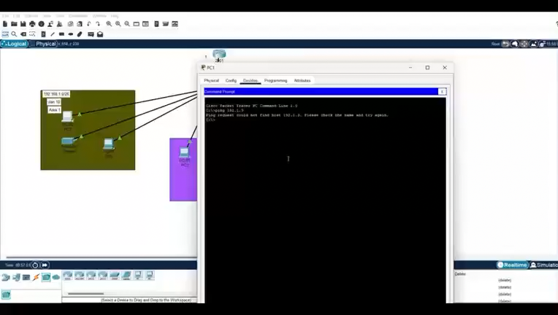

Slide 11
